Slide 1
Object-oriented Programming
Week 5

Slide 2
What are initializer lists in C++?
The initializer list is used to directly initialize data members of a class. An initializer list starts after the constructor name and its parameters. The list begins with a colon ( : ) and is followed by the list of variables that are to be initialized – all of​ the variables are separated by a comma with their values in curly brackets.

Slide 3
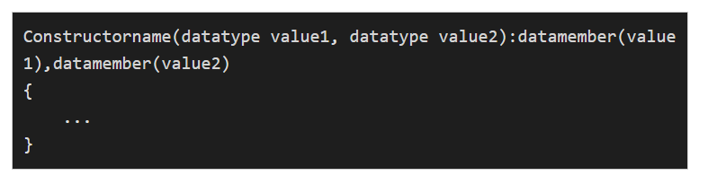
Syntax

Slide 4
Example
#include <iostream>
class car{
int a;
public:
car(int e):a(e){}
// the above initialization is same as
// car(int e){
// a=e;
// }
void print(){
std::cout<<a; }
};
int main(){
car c(10);
c.print();
}

Slide 5
Using {} this is uniform initialization(in C++11) and preferred
class car{
char x;
public:
car(int a):x{a}{
}
};
int main(){
car c(10);
}

Slide 6
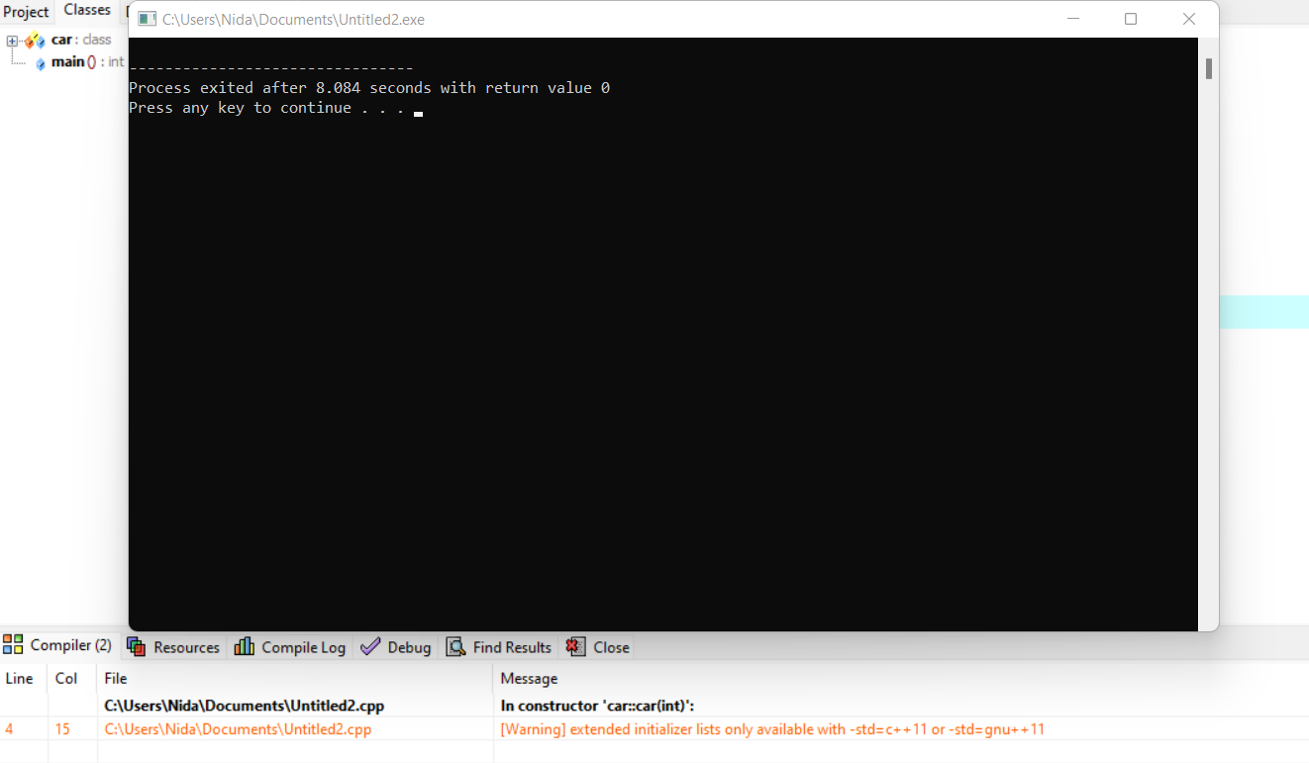
Giving us warning (narrowing conversion)

Slide 7
Using ()
class car{
char x;
public:
car(int a):x(a){
}
};
int main(){
car c(10);
}

Slide 8
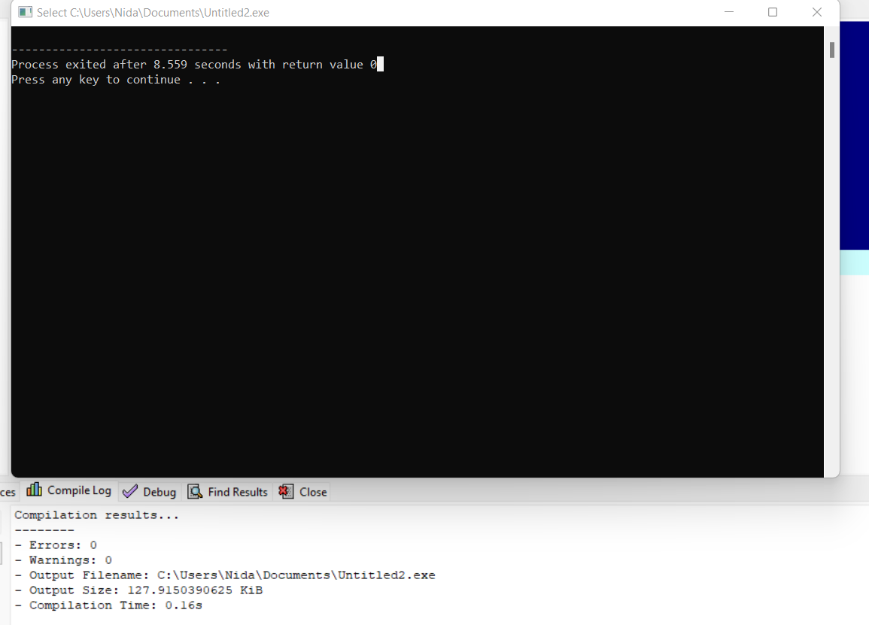
No warning

Slide 9
What Are All Those Places Where Initializer List Is Must In C++?
1. For Performance reasons: It is better to initialize all class variables in Initializer List instead of assigning values inside body.
2. For initialization of non-static const data members(we’ll see this in later example)
3. For initialization of base class members : the parameterized constructor of the base class can only be called using Initializer List.(don’t worry we’ll use this concept in inheritance)

Slide 10
4.When constructor’s parameter name is same as data member
#include <iostream>
class car{
int a;
public:
car(int a):a(a){
}
void print(){
std::cout<<a;
}
};
int main(){
car c(10);
c.print();
}

Slide 11
this Pointer is Not Available for Initialization
#include <iostream>
class car{
int a;
public:
car(int a):this->a(a){
}
void print(){
std::cout<<a;
}
};
int main(){
car c(10);
c.print();
}

Slide 12
this Pointer is Not Available for Initialization
this is a pointer to the current instance of the object.
However, at the time of the initializer list execution,
the object is not fully constructed yet.
Since this refers to an object that is still being built,
C++ does not allow you to use this in an initializer list.

Slide 13
5. For initialization of reference members:
#include <iostream>
class car{
int &a;
public:
car(int a):a(a){
}
void print(){
std::cout<<a;
}
};
int main(){
car c(10);
c.print();
}

Slide 14
Output?
#include <iostream>
class car{
int &a;
public:
car(int a){
this -> a = a;
}
void print(){
std::cout<<a;
}
};
int main(){
car c(10);
c.print();
}

Slide 15
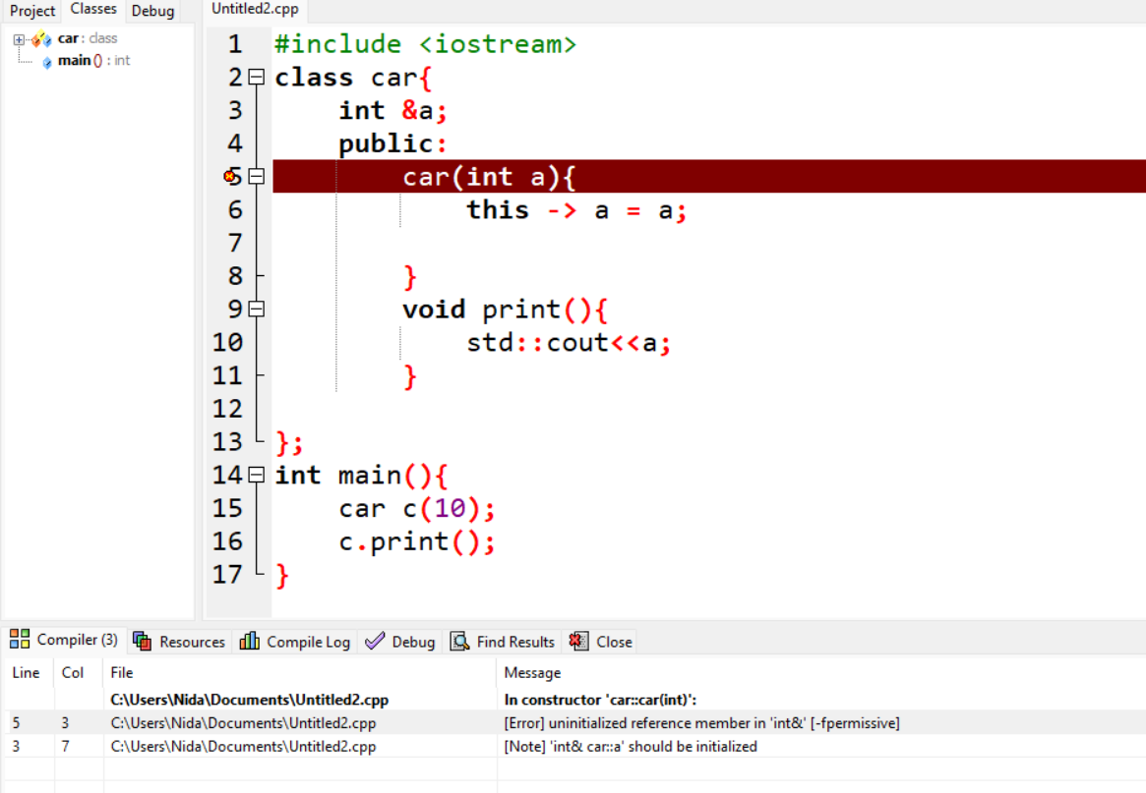
output

Slide 16
Constant Variables
The keyword const be used to declare constant variables
They must be initialized when they are declared and cannot be modified later
Using constant variables to specify array size makes program more scalable
Constant variables are also called named constants or read-only variables

Slide 17
Constant Variables
int main()
{
const int a = 5;
const int b; // will cause error
b = 10; // will cause error
const int arr[] = {1, 2, 3, 4, 5};
arr[0] = 10; // will cause error
}

Slide 18
Member Initialization List
Constant class members can only be initialized through constructor’s member initialization list
The list of members to be initialized is indicated with constructor as a comma-separated list followed by a colon

Slide 19
Member Initialization List
class A{
const int x;
const int y;
public:
A ( int val1 , int val2 ) {
x=val1; // error
x=val2;} // error
};
int main() {
A a ( 5 , 10 );}

Slide 20
Member Initialization List
class A{
const int x;
const int y;
public:
A ( int val1 , int val2 ) : x ( val1 ) , y ( val2 )
{}
};
int main() {
A a ( 5 , 10 );}

Slide 21
Constant Parameters
int func(const int a, int b)
{
a += 10; //will cause error
b += 20;
}

Slide 22
CONSTANT MEMBER FUNCTIONS
Constant member function is the function that cannot modify the data members.
To declare a constant member function, write the const keyword after the closing parenthesis of the parameter list. If there is separate declaration and definition, then the const keyword is required in both the declaration and the definition.
Constant member functions are used, so that accidental changes to objects can be avoided. A constant member function can be applied to a non-constobject.
Keyword, const can't be used for constructors and destructors because the purpose of a constructor is to initialize data members, so it must change the object. Same goes for destructors.

Slide 23
#include<iostream>
using namespace std;
class Demo {
int val;
public:
Demo(int x = 0) {
val = x;
}
int getValue() const {
val=2; //[Error] assignment of member 'Demo::val' in read-only object
return val;
}
};
int main() {
Demo d1(8);
cout << "\nThe value using object d1 : " << d1.getValue();
return 0;
}

Slide 24
principle of least privilege
how the principle of least privilege applies to objects?
Some objects need to be modifiable, and some do not. You may use keyword const to specify that an object is not modifiable and that any attempt to modify the object should result in a compilation error.

Slide 25
CONSTANT OBJECTS
As with normal variables we can also make class objects constant so that their value can't change during program execution. Constant objects can only call constant member functions. The reason is that only constant member function will make sure that it will not change value of the object. They are also called as read only objects. To declare constant object just write const keyword before object declaration.

Slide 26
CONSTANT OBJECTS
class Demo {
public:
int val;
Demo(int x = 0) {
val = x;}
int getValue() const {
return val; }
int getValue1() {
return val;}};
int main() {
const Demo d(28);
cout << "The value using constant object d : " << d.getValue();
cout << "\nThe value using object d non const func : " << d.getValue1();//error
d.val=10;// error, can't modify const objects
return 0;
}

Slide 27
CONSTANT OBJECTS
A constructor must be a non-const member function but it can still be used to initialize a const object) shows that it calls another non-const member function. Invoking a nonconst member function from the constructor call as part of the initialization of a const object is allowed. The “constness” of a const object is enforced from the time the constructor completes initialization of the object until that object’s destructor is called.

Slide 28
Principle of Least Privilege???

Slide 29
Constant With Pointers
There are four ways to use const with pointers:
Non-constant pointers to non-constant data
Non-constant pointers to constant data
Constant pointers to non-constant data
Constant pointers to constant data

Slide 30
Non-constant Pointers to Non-constant Data
The highest access is granted by a non-constant pointer to non-constant data
Data can be modified through pointer, and pointer can be made to point to other data

Slide 31
Non-constant Pointers With Non-constant Data
int main()
{
int a = 10;
int b = 50;
int* pA = &a;
*pA = 20;
pA = &b;
}

Slide 32
Non-constant Pointers to Constant Data
Pointer can be modified to point to any other data, but the data to which it points cannot be modified through that pointer
const int * p;
Or
int const *p;

Slide 33
Non-constant Pointers to Constant Data
int main()
{
int a = 10;
int b = 50;
const int* pA = &a;
*pA = 20; // this line will cause error
pA = &b;
}

Slide 34
int main()
{
int a = 10;
int b = 50;
const int* pA;
pA = &a;
pA = &b;
a=23;
}

Slide 35
Constant Pointers to Non-constant Data
Always points to the same memory location, but the data at that location can be modified through the pointer
int * const p = &val;
//here pointer is constant, so we need to assign value immediately

Slide 36
Constant Pointers to Non-constant Data
int main()
{
int a = 10;
int b = 50;
int* const pA = &a;
*pA = 20;
pA = &b; // this line will cause error
}

Slide 37
Constant Pointers to Constant Data
Always points to the same memory location, and the data at that location cannot be modified via the pointer
const int * const p = &val;
or
int const * const p = &val;

Slide 38
Constant Pointers to Constant Data
int main()
{
int a = 10;
int b = 50;
const int* const pA = &a;
*pA = 20; // cannot do this
pA = &b; // cannot do this as well
}

